Slide 1
Dracula Untold:
Cinematic Vampires
Megan Hall
Dr. Craig Fischer
12/4/2015

Slide 2
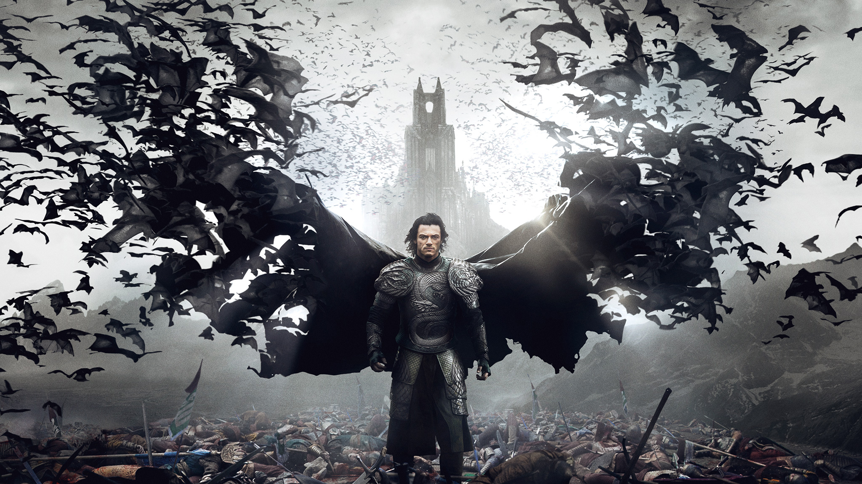
Dracula Untold
Director: Gary Shore
Release Date: October 10, 2014
Origin story of Vlad Tepes III becoming Dracula
Main Cast: Luke Evans (Vlad Tepes III/Dracula), Sarah Gadon (Mirena), Art Parkinson (Igneras), Dominic Cooper (Sultan Mehmed II), & Charles Dance (Master Vampire)

Slide 3
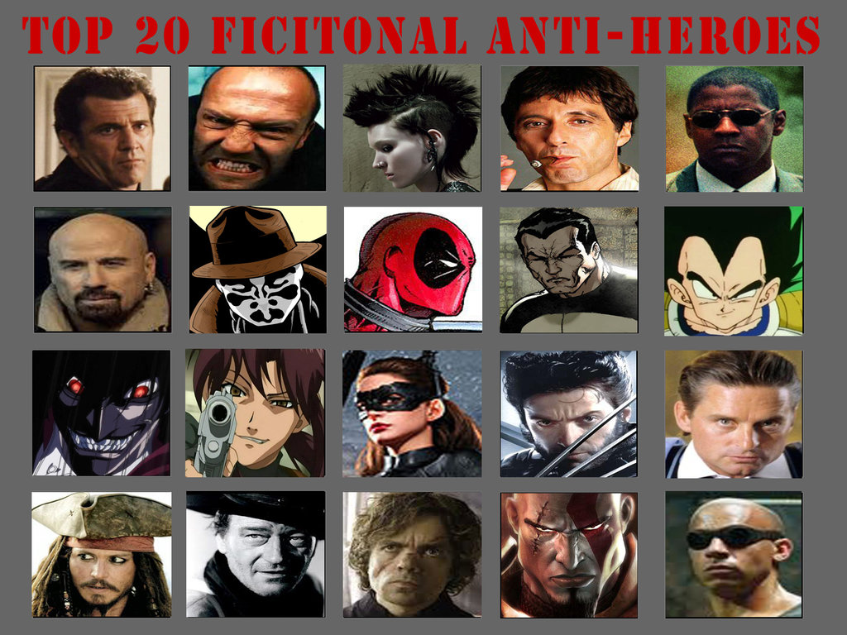
Characteristics of an Anti-hero
An anti-hero is someone who is lacking in all the heroic qualities and has a major, or fatal, flaw.
The flaw doesn't always lead to their demise.
The anti-hero is compared to and possibly derived from the tragic hero.
Can achieve victory and/or redemption.
Notes:
http://study.com/academy/lesson/anti-hero-definition-examples-characteristics.html

Slide 4
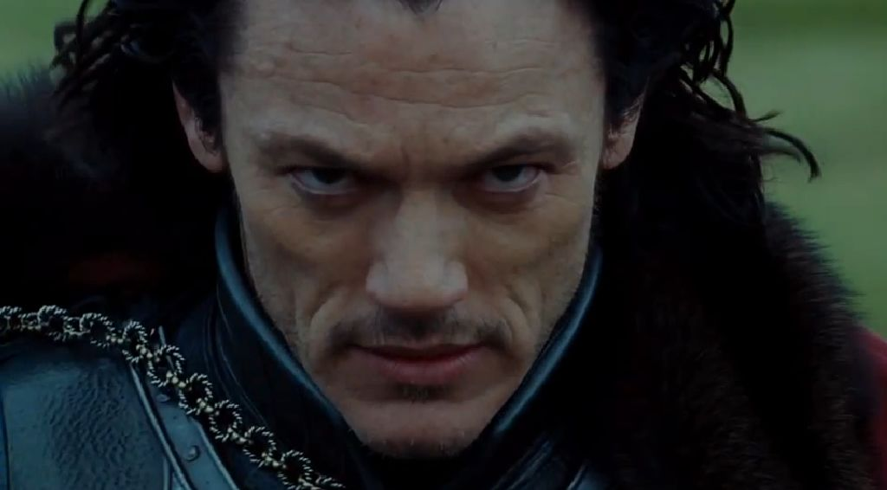
Vlad Tepes III as an anti-hero
Vlad was taken by the Sultan of Turkey when he was a boy.
He grew up along side Mehmed and saw each other as a brother.
He used wooden stakes in order to display those that he killed in psychological warfare.
He escaped from his duty as a soldier and became Prince of Wallachia (Romania).
He is not very proud of what he has done in his past.
He wants a bright future with his family and people.
Finds a way to protect his family and people from Sultan Mehmed II when he comes asking for 1,000 boys and Vlad's son, Ingeras.
He goes to the Master Vampire in order to get the power needed to protect his people and family.

Slide 5
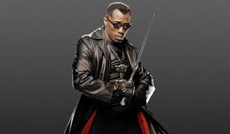
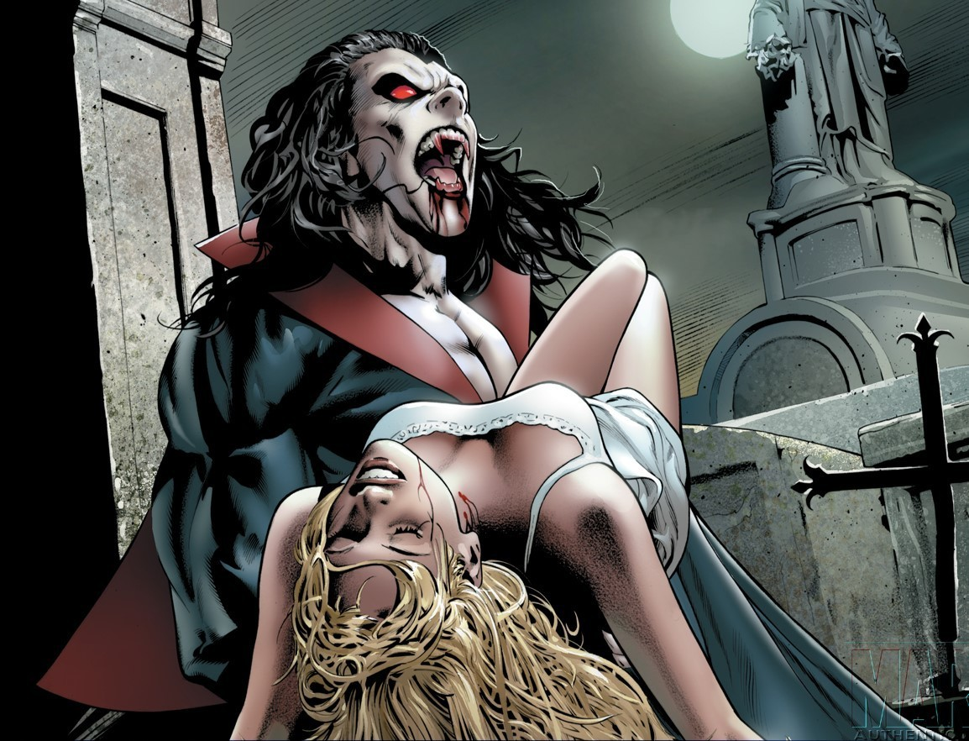
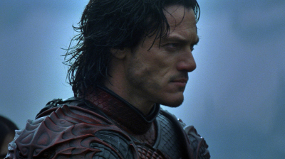
Cinematic Vampires
Vampiric Heroes/Anti-heroes
Vampiric Villains

Slide 6
Cinematic Vampires Cont.
Vampire Heroes/Anti-heroes
Vampire Villains
Some of the characteristics & personality traits of a villain
Is given the goals and desires of a hero
Has a disturbing background that has resulted in their present state of being
Goes through mental & spiritual conflicts within themselves
Is given plenty of room to grow both mentally & spiritually
Their motive, sometimes, for doing something right just for the sake of doing what is right
Can also be getting something in return/profit
Seen as vigilantes or criminals in the eyes of the established law (Scott)
Extremely more powerful than the hero/anti-hero
How they used said strength & power
How they are defeated
Character & motivations
Iconic origins & relationship to the hero
Composure
Distinctive look
Ruthless conviction
Mystery
Being "relatable" ("A Dime On")

Slide 7
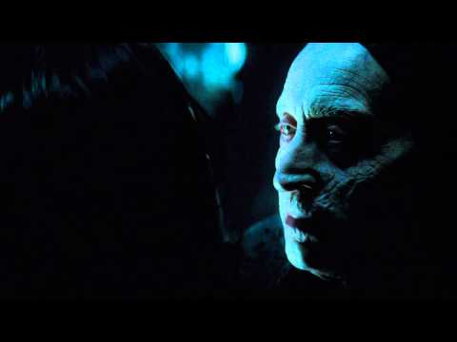
Anti-Hero VS. Villain

Slide 8
Thank You For Your Time And Patience
Works Cited
"A Dime On: 10 Traits of Highly-Effective Villains." Some Loose Change A Movie Blog. 16 June 2011. Web. 2 Dec. 2015.
Love, Scott. "THE ANTI-HERO." THE ANTI-HERO. Web. 2 Dec. 2015.

