Slide 1
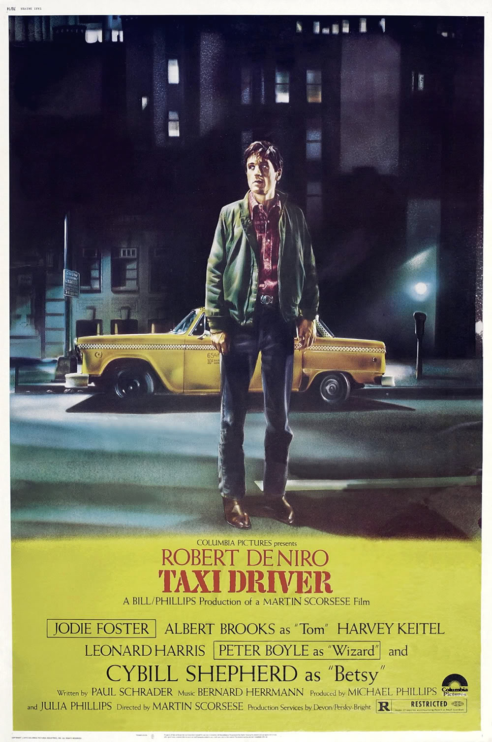
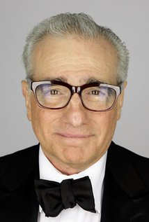
Director’s message in Taxi Driver
Megan Hall
Appalachian State University

Slide 2
Summary of Taxi Driver
Travis Bickle, an ex-Marine who served in the Vietnam War
Suffers from insomnia
Drives a New York City taxi during the night
‘Falls in love’ with Betsy, who works for the presidential campaign for Senator Palantine
Unrecipericated love; becomes obsessed with her
Attempts to kill Senator Palantine, he fails
Eventually, attempts & succeeded in saving Iris, a 12-year-old runaway & prostitute
Becomes a hero & still works as a taxi driver

Slide 3
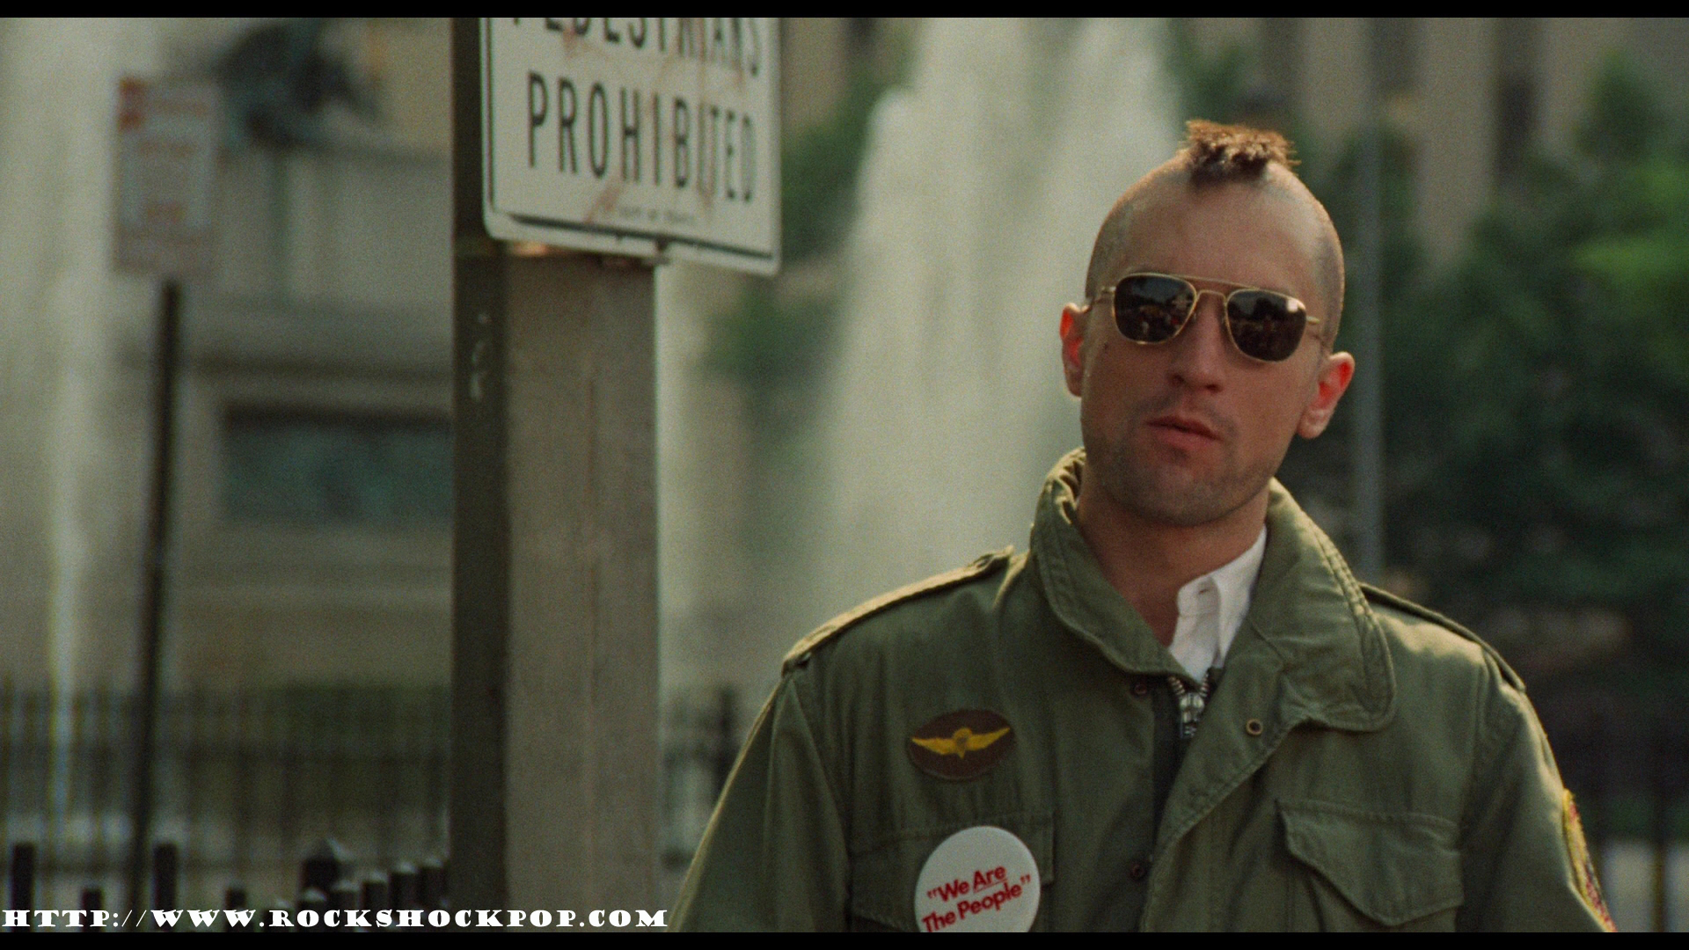
Dialogue: Travis
Talks about the ‘scum’ in New York City that comes out at night
Wants to clean up the streets
Eventually, gets guns illegally and has them with him
Is mentally unstable
Shaves his hair into a Mohawk
Goes on a killing spree at the pimp’s house to save Iris
Doesn’t ask questions before hand

Slide 4


Music
Mostly jazzy with places that are silent and has normal sounds of the city
Gets dark and dramatic when Travis talks into the mirror and when he starts killing people in the pimp’s house
Amplifies his mental instability

Slide 5
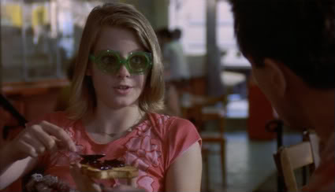
Additional Information
Travis most likely had PTSD from his time in the military.
He feels that he could still do good in New York City and starts with trying to save Iris from prostitution and the pimp she is with.
Iris most likely felt like she was not wanted by her parents; at the end, is greatly mistaken.
She finally understood that her life could be much better than prostitution.

